Slide 1
History of Ayresome Park: Ayresome in numbers

Slide 2
Ayresome in Numbers: Literacy Comprehension
with Tosh Warwick (Manchester Metropolitan University)
and Chris Bartley (St Joseph’s Catholic Primary School, Middlesbrough)

Slide 3
Ayresome in Numbers: Literacy Comprehension
Today’s task is inspired by facts and figures from Middlesbrough Football Club’s time at Ayresome Park. The task will help with your numeracy and explore changes over time. You will also need to use your literacy skills to observe the text closely to help you answer the questions.

Slide 4
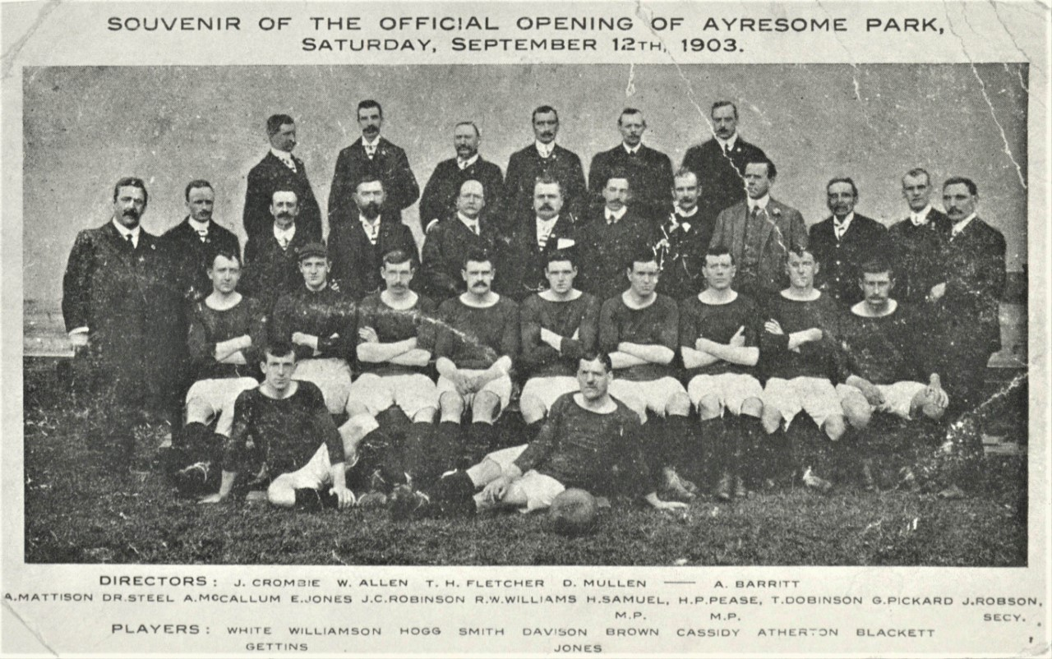
Facts and Figures
During Middlesbrough Football Club’s time at Ayresome Park (1903-1995), the stadium witnessed a number of record-breaking fixtures and special matches. Below are some fascinating facts and figures about Ayresome Park:
First League Match: On Saturday 12th September 1903, Boro’s first league match at Ayresome Park attracted an attendance of 30,000 people.
Record Highest Attendance: A record-breaking 53,802 attended Boro’s home match against Newcastle United on Tuesday 27th December 1949.
Record League Win: On Saturday 23rd August 1958, Boro achieved their record league win with a 9-0 victory over Brighton & Hove Albion.
Inspire CONFIDENCE Inspire HOPE

Slide 5
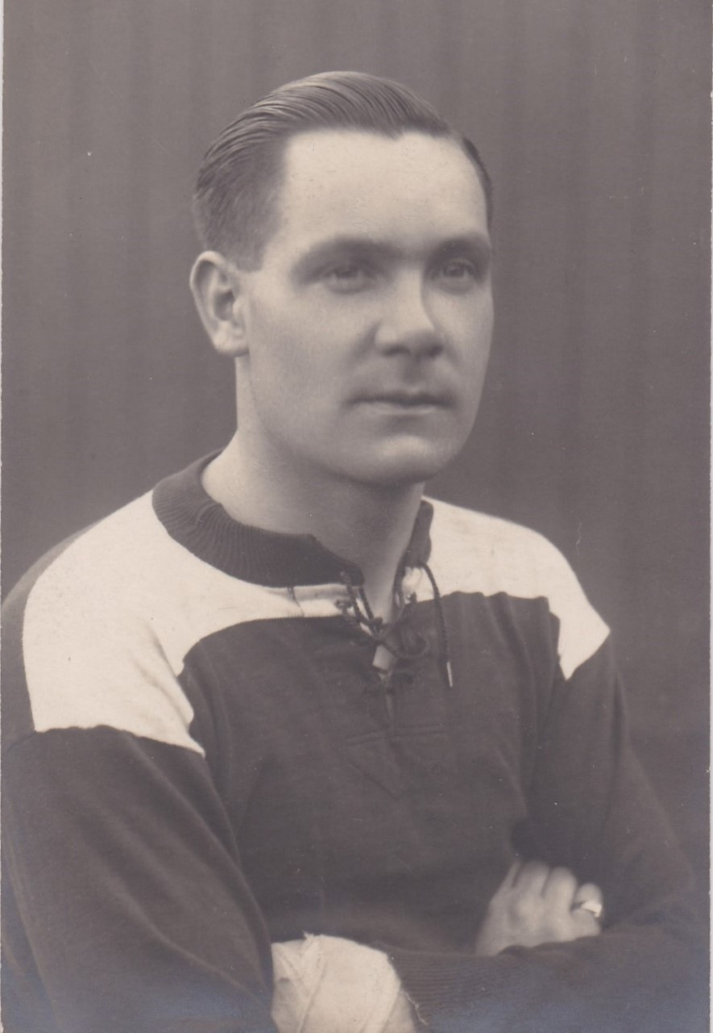
Facts and Figures
Most Goals Scored for Boro in a League Match at Ayresome Park: Only three Boro players managed to score five goals in one match at Ayresome Park. These are:
Andy Wilson vs Nottingham Forest on 6th October 1923
George Camsell vs Aston Villa on 9th September 1935
Brian Clough v Brighton & Hove Albion on 23rd August 1958
Inspire CONFIDENCE Inspire HOPE

Slide 6
Facts and Figures
World Cup Matches: In 1966, Boro’s Ayresome Park hosted three matches as part of the FIFA World Cup. This meant international football teams from around the world came to Middlesbrough to play in the World Cup tournament. The matches held at Ayresome Park were:
North Korea 0-3 Soviet Union Attendance: 23,006
North Korea 1-1 Chile Attendance: 13,792
North Korea 1-0 Italy Attendance: 17,829

Slide 7
Questions
1) How many years was Ayresome Park the home of Middlesbrough Football Club?
2) How many people attended the first league match at Ayresome Park in 1903?
3) How many more people attended the first league match at Ayresome Park in 1903 compared to the last league match in 1995?
4) Who was the first player to score five league goals in one match for Middlesbrough at Ayresome Park?
5) How many years ago did Middlesbrough achieve their record league win at Ayresome Park?

Slide 8
Questions
6) What was the total aggregate attendance of all three World Cup matches held at Ayresome Park in 1966?
7) How many goals in total were scored in the FIFA World Cup matches held at Ayresome Park in 1966?
8) What was the record-breaking size of the advertisement on Ayresome Park’s North Stand?
9) How many goals were scored in Middlesbrough’s final league match at Ayresome Park against Luton Town?
10) How many more people attended the match against Luton Town in 1995 compared to the record-breaking match against Newcastle United in 1949?

Slide 9
Facts and Figures
A World Record Sponsor: In 1989, the Guinness Book of Records declared that - at a size of 86.56m (284ft) x 25m (82ft) - the advertisement on the North Stand was the largest advertising hoarding in the world!
Last League Match: Middlesbrough’s final league match at Ayresome Park was held on Sunday 30th April 1995. A crowd of 23,903 witnessed John Hendrie score two goals as Boro won 2-1 against Luton Town.

Slide 10
Notes for Teachers
Chris Bartley (St Joseph’s Catholic Primary School, Middlesbrough) and Dr Tosh Warwick (Manchester Metropolitan University) have developed this resource in partnership with MFC Foundation. The resource is based upon research carried out by Dr Tosh Warwick and Shaun Wilson, including articles featured in the ‘Ayresome Memories’ section of the Middlesbrough Football Club website: https://www.mfc.co.uk/club-community/club/mfc-history/ayresome-memories.
Numeracy (KS1)
Ask and answer questions about totalling and comparing categorical data.
Numeracy (KS2)
Solve one-stop and two-step questions (for example, 'How many more?' and 'How many fewer?’.
History (KS1)
Understanding people and places in their own locality.
History (KS2)
Understanding an aspect of local history over time.

Slide 11
Further Reading
Harry Glasper (1993), Middlesbrough: A Complete Record (Derby, Breedon)
Harry Glasper and Chris Kershaw (1998), The Boro Bible: A Complete History of Middlesbrough Football Club (Bishop Auckland, Hillprint)
Eric Paylor and John Wilson (2004), Ayresome Park Memories (Derby, Breedon)
Richard Piers Rayner (2008), Middlesbrough FC: The Unseen History (Derby, Breedon)

