Slide 1
History of Ayresome Park: Aerial Ayresome

Slide 2
Aerial Ayresome
with Tosh Warwick (Manchester Metropolitan University)
and Chris Bartley (St Joseph’s Catholic Primary School, Middlesbrough)

Slide 3
Aerial Ayresome
Today’s task investigates the changes that have taken place over time in Middlesbrough by looking at maps, plans and photographs from the past two centuries. By exploring the site where Ayresome Park once stood at different points in its history, you will improve your skills in recognising landmarks and physical features in the local area over time.

Slide 4
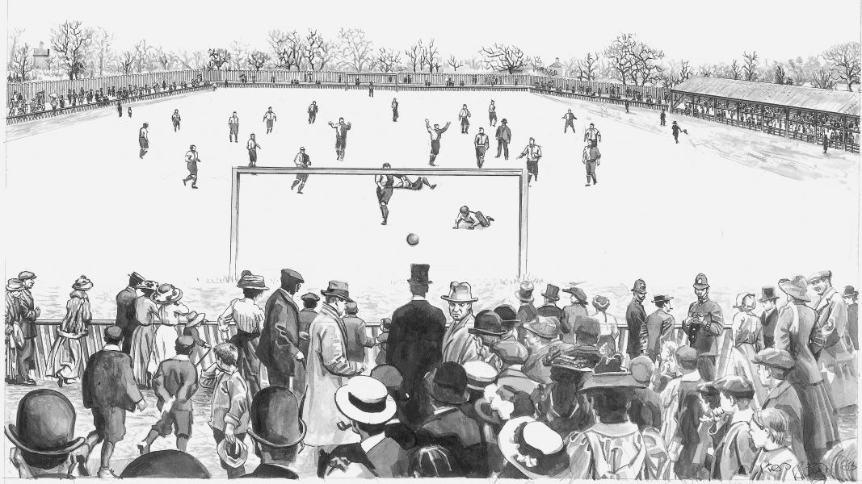
Before Ayresome Park
Middlesbrough Football Club have moved home a number of times since the club’s formation in 1876. Before moving to Ayresome Park, Boro played home matches at Albert Park’s Archery Ground, Breckon Hill and the Linthorpe Road Ground.
Pictured here is a piece of artwork by Richard Piers Rayner imagining how Boro’s former Linthorpe Road Ground might have looked.
Before Ayresome Park was built, another football ground stood on the site of Ayresome Park. This was named Paradise Ground and was the home of Boro’s rivals Middlesbrough Ironopolis.
Inspire CONFIDENCE Inspire HOPE

Slide 5
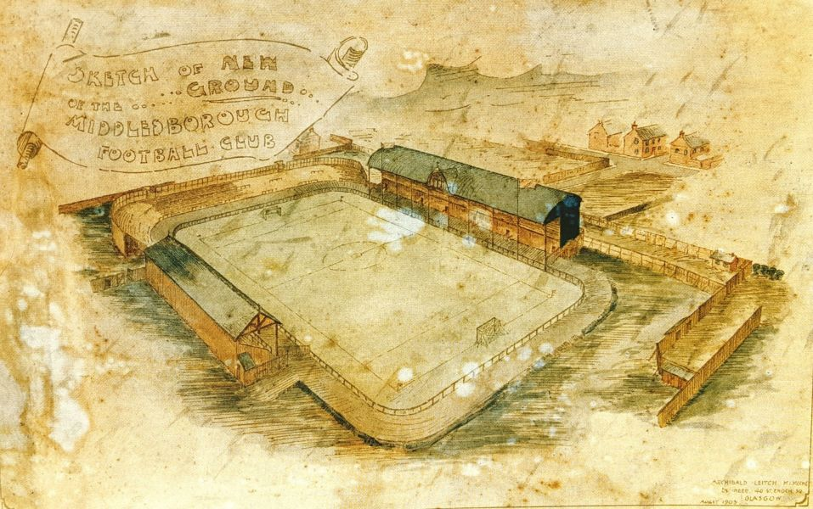
The Move to Ayresome Park
Boro moved to Ayresome Park in 1903 and the ground was the club’s home for 92 years until they moved to the Riverside Stadium in 1995.
During the club’s time at Ayresome Park, although much of the stadium and surrounding area remained the same, there were also a number of changes.
A number of alterations to Ayresome Park occurred over the years and many of the spaces and streets near to the stadium also experienced change.
Inspire CONFIDENCE Inspire HOPE

Slide 6
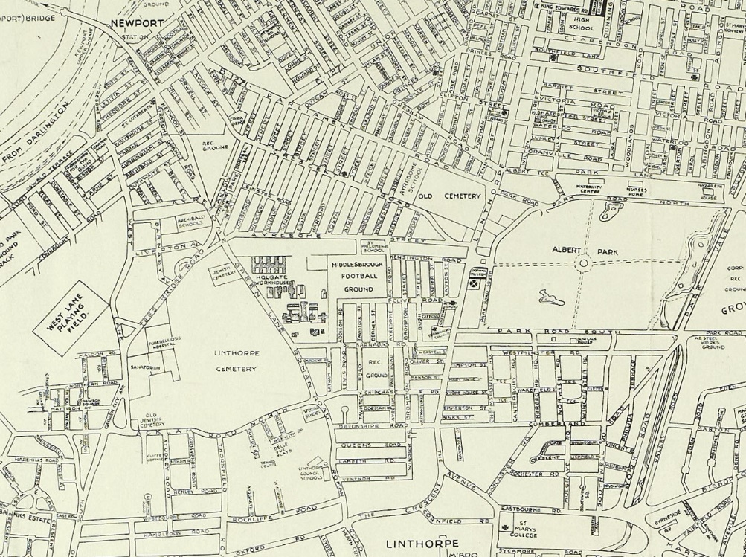
Aerial photos, maps and plans
One of the best ways to discover changes to an area over time is by using maps, photographs and plans from different points in history.
Maps, photographs and plans often provide an aerial or overhead perspective of the area.
This allows change and continuity to be easily identified by comparing maps, photographs and plans from different periods in time.
Inspire CONFIDENCE Inspire HOPE

Slide 7
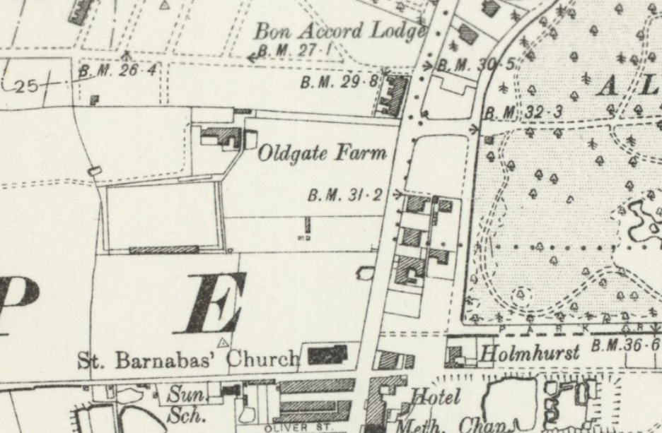
Map of Middlesbrough 1899
NLS https://maps.nls.uk/os/
Inspire CONFIDENCE Inspire HOPE

Slide 8
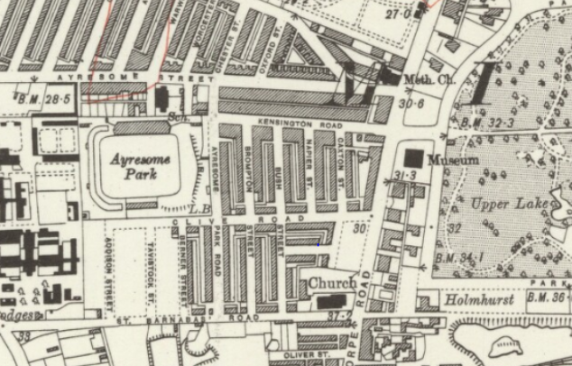
Map of Middlesbrough published 1923
NLS https://maps.nls.uk/os/
Inspire CONFIDENCE Inspire HOPE

Slide 9
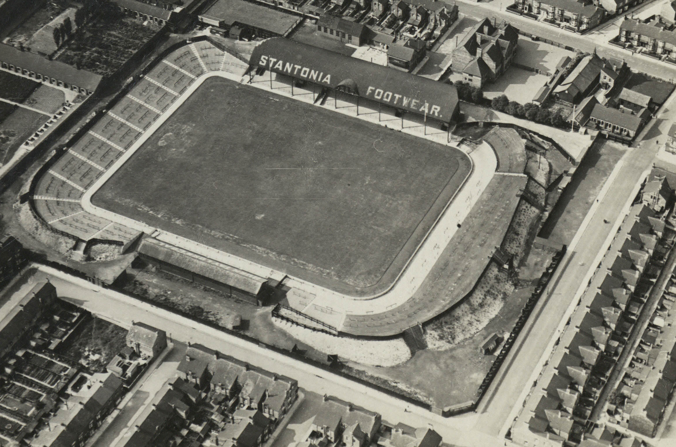
Aerial photo of Ayresome Park 1934
Middlesbrough Libraries
Inspire CONFIDENCE Inspire HOPE

Slide 10
Map of Middlesbrough 1935
Courtesy of Teesside Archives
Inspire CONFIDENCE Inspire HOPE

Slide 11
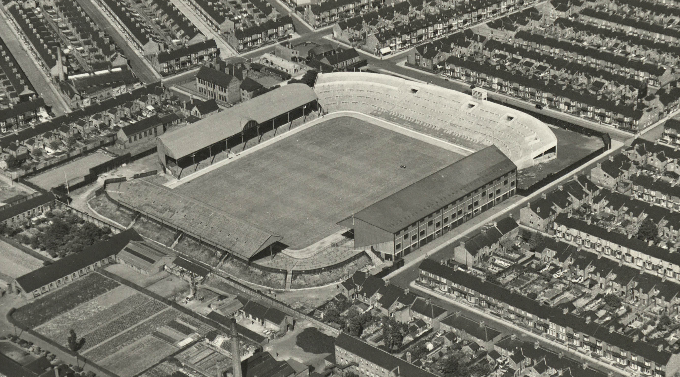
Aerial photo of Ayresome Park 1951
Middlesbrough Libraries
Inspire CONFIDENCE Inspire HOPE

Slide 12
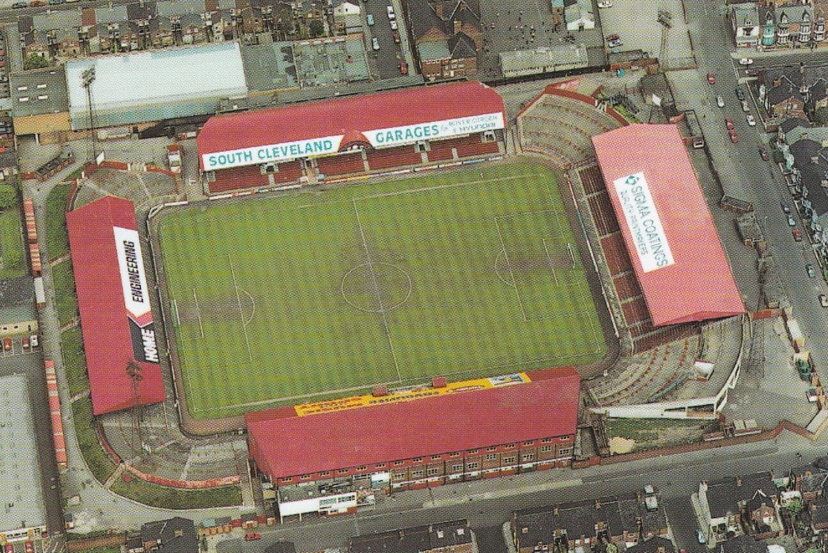
Aerial photo of Ayresome Park 1990s
Harry Greenmon
Inspire CONFIDENCE Inspire HOPE

Slide 13
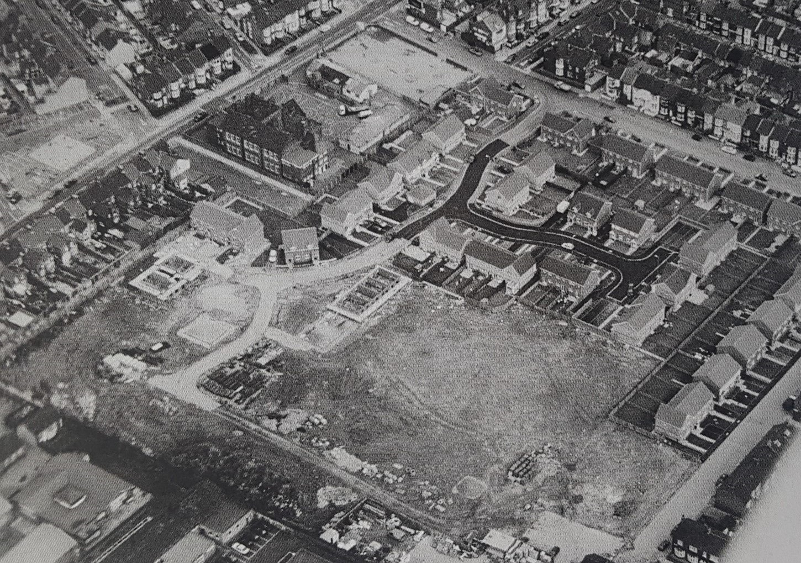
Aerial photo after stadium demolition
The Gazette
Inspire CONFIDENCE Inspire HOPE

Slide 14
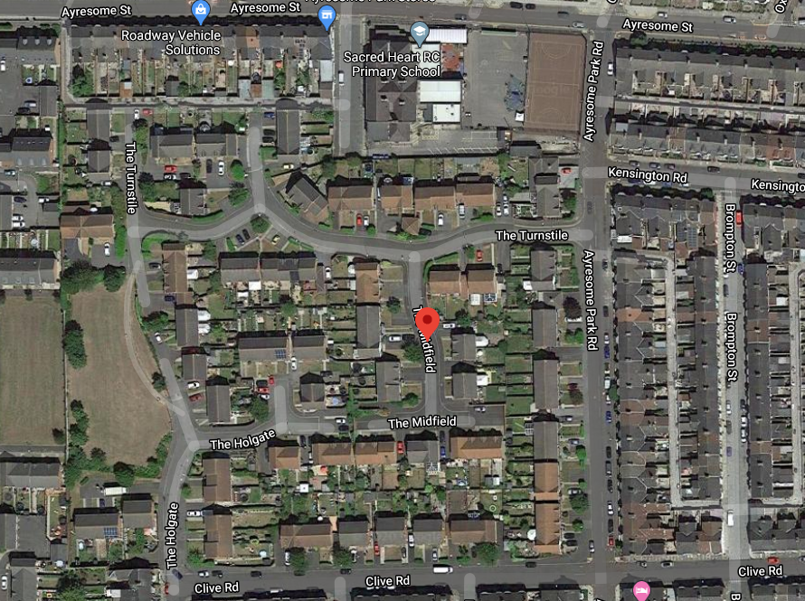
Aerial view from Google Maps 2020
Google Maps 2020
Inspire CONFIDENCE Inspire HOPE

Slide 15
Questions
What buildings can you identify on the future site of Ayresome Park in the 1899 map?
Compare the 1899 and 1923 maps. How has the area changed in this time?
Compare the aerial photos of Ayresome Park from the 1930s and 1950s. How has Ayresome Park changed? (hint: count the stands of the stadium)
Compare the aerial photos of Ayresome Park from the 1930s and 1990s. Name the two sponsors shown on the stand circled in red.
What is located on the site of Ayresome Park today?
Can you identify any street names relating to football in the 2020 Google Map?

Slide 16
Extra activity
The National Library of Scotland includes a number of maps of Middlesbrough throughout the years: https://maps.nls.uk/
Can you find the following locations on the maps:
Boro’s old Linthorpe Road Ground (hint: this appears on 1880s and 1890s maps)?
Any other sports grounds or stadiums located in Middlesbrough since the 1880s?
The future site of the Riverside Stadium?

Slide 17
Virtual Classroom Activity
Can you create your own Map?
You can base this on the old maps of Ayresome Park, the Riverside Stadium, or your own area which surrounds your home.
Top Tips:
Complete your map in black and white to make it look like it was from an earlier time.
Stain your map with tea or coffee (cold – get an adult to help you) or crumple it up, to make it look like it was discovered during a historic dig by architects!
We have put together a template example for you. You can start by identifying a place of interest e.g. Riverside Stadium or your home, and then build around it.
Inspire CONFIDENCE Inspire HOPE

Slide 18
Inspire CONFIDENCE Inspire HOPE

Slide 19
Notes for Teachers
Chris Bartley (St Joseph’s Catholic Primary School, Middlesbrough) and Dr Tosh Warwick (Manchester Metropolitan University) have developed this resource in partnership with MFC Foundation.
Geography (KS1)
• Use aerial photographs and plan perspectives to recognise landmarks.
Geography (KS2)
• Observe physical features in the local area using a range of methods, including aerial maps, plans and graphs, and digital technologies.
History (KS1)
• Understanding people and places in their own locality.
History (KS2)
• Understanding an aspect of local history over time.

Slide 20
Further Reading
Harry Glasper (1993), Middlesbrough: A Complete Record (Derby, Breedon)
Harry Glasper and Chris Kershaw (1998), The Boro Bible: A Complete History of Middlesbrough Football Club (Bishop Auckland, Hillprint)
Eric Paylor and John Wilson (2004), Ayresome Park Memories (Derby, Breedon)
Richard Piers Rayner (2008), Middlesbrough FC: The Unseen History (Derby, Breedon)

